Slide 1
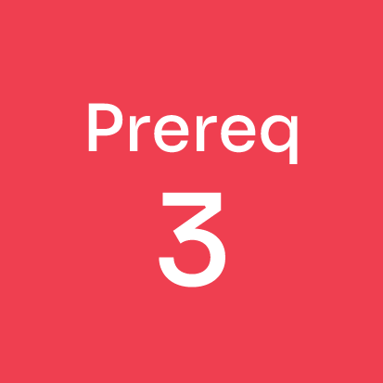
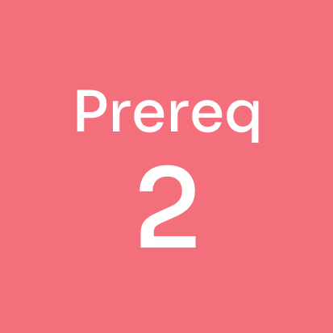

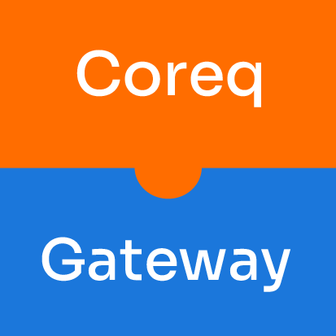

Slide 2
Discussion Questions
Did you notice any patterns or trends in the collective results of all players in the game? Which students are more likely to finish within one or two semesters? Which students take longer or are more likely to drop out? What factors contribute to these patterns?
How did being placed in either a traditional prerequisite remediation course or a coreq course affect your own progress in reaching and completing the College-Level Gateway Course within two semesters? Within four semesters? Does corequisite support provide a structural solution to improve student success?
How do your college’s structures and supports help students succeed—or make it harder for student to succeed?
When this game is played multiple times, there tend to be more dropouts than students who take five or six semesters to complete the College-Level Gateway Course. Why do you think this occurs? Do these results match the real-world results seen among students at our institution?
How does remediation affect the cost (time and money) of education for students? How do different structures for remediation affect this cost?
Compare the experiences of students who passed the College-Level Gateway Course in one semester with those who took longer to reach and complete a College-Level Gateway Course. How do different structures for remediation affect students’ perceptions of your college and their own ability to learn and succeed?

Slide 3
Discussion Questions
For those who completed the game quickly, what was it like to observe your peers dropping out, stopping out, or taking longer to finish? For those who took longer to complete the game or dropped out, what was it like to see your peers go farther or finish faster than you did?
At your institution, are certain groups of students disproportionately assigned to remediation? What impact do these placements have on historically excluded students, students from under-resourced communities, first-generation students, and returning adult learners?
Do college placement policies foster successful remediation on your campus? Can the policies be changed to be more student centered? To focus more on strengths than weaknesses?
Students in the Coreq Course earned two Success Points when pairing Pedagogy Cards and Support Cards, whereas everyone else earned one Success Point for that pairing. Why do you think the game was designed in this way? How should coreq courses be optimized in design and instruction to elevate student success?
As the game unfolded, did it seem like the players who began in prerequisite remediation courses had the highest risk of stopping out or dropping out? If so, why do you think that was the case? Did it seem like bad luck or part of the system?
During the game, you may have had semesters during which you excelled and others during which you faced many challenges and obstacles. How does this variation relate to the experiences that students at your college face?

