Slide 1
Building Momentum in Montana

Slide 2
The Complete College Montana Story:
Building Momentum in Montana
John Cech
Deputy Commissioner of Academic, Research, and Student Affairs
OCHE
Erik Rose
Director of Workforce Initiatives & Information
OCHE

Slide 3
Momentum Points
Building Mass Gaining Velocity
Notes:
John

Slide 4
FOUNDATION
Supportive Board of Regents
Central Data Warehouse
Performance Based Funding
Policy that Promotes Success
Systemwide Collaboration
Common Course Numbering
Notes:
John

Slide 5
Pillars of Support
Steve Bullock
Governor of the State of Montana
Clay Christian
Commissioner of Higher Education
Notes:
Erik

Slide 6
First Steps
Collected Data
Identified Gaps
Gained Stakeholder Buy-in
Observed Other States
Notes:
John

Slide 7
Math Pathways Taskforce Year 1 – Defining the Problem
Notes:
John

Slide 8
Math Pathways Taskforce Year 2 – Plan of Action
Provide a Clear Remedial Options for Non-STEM Majors
Develop Alternative Pathways for Non-STEM Majors
Strengthen Advising Processes for Math
Re-assess Math Requirement for all Programs
Notes:
Erik

Slide 9
Math Pathways Results
Notes:
Erik

Slide 10
Shift to Co-Requisite
Notes:
Erik

Slide 11
Campus Champions
Helena College
MSU- Billings
Notes:
Erik

Slide 12
Challenges Specific to Co-requisite English
Notes:
John

Slide 13
Learn
Plan
Commit
Summer Action Summit 2017
Notes:
John

Slide 14
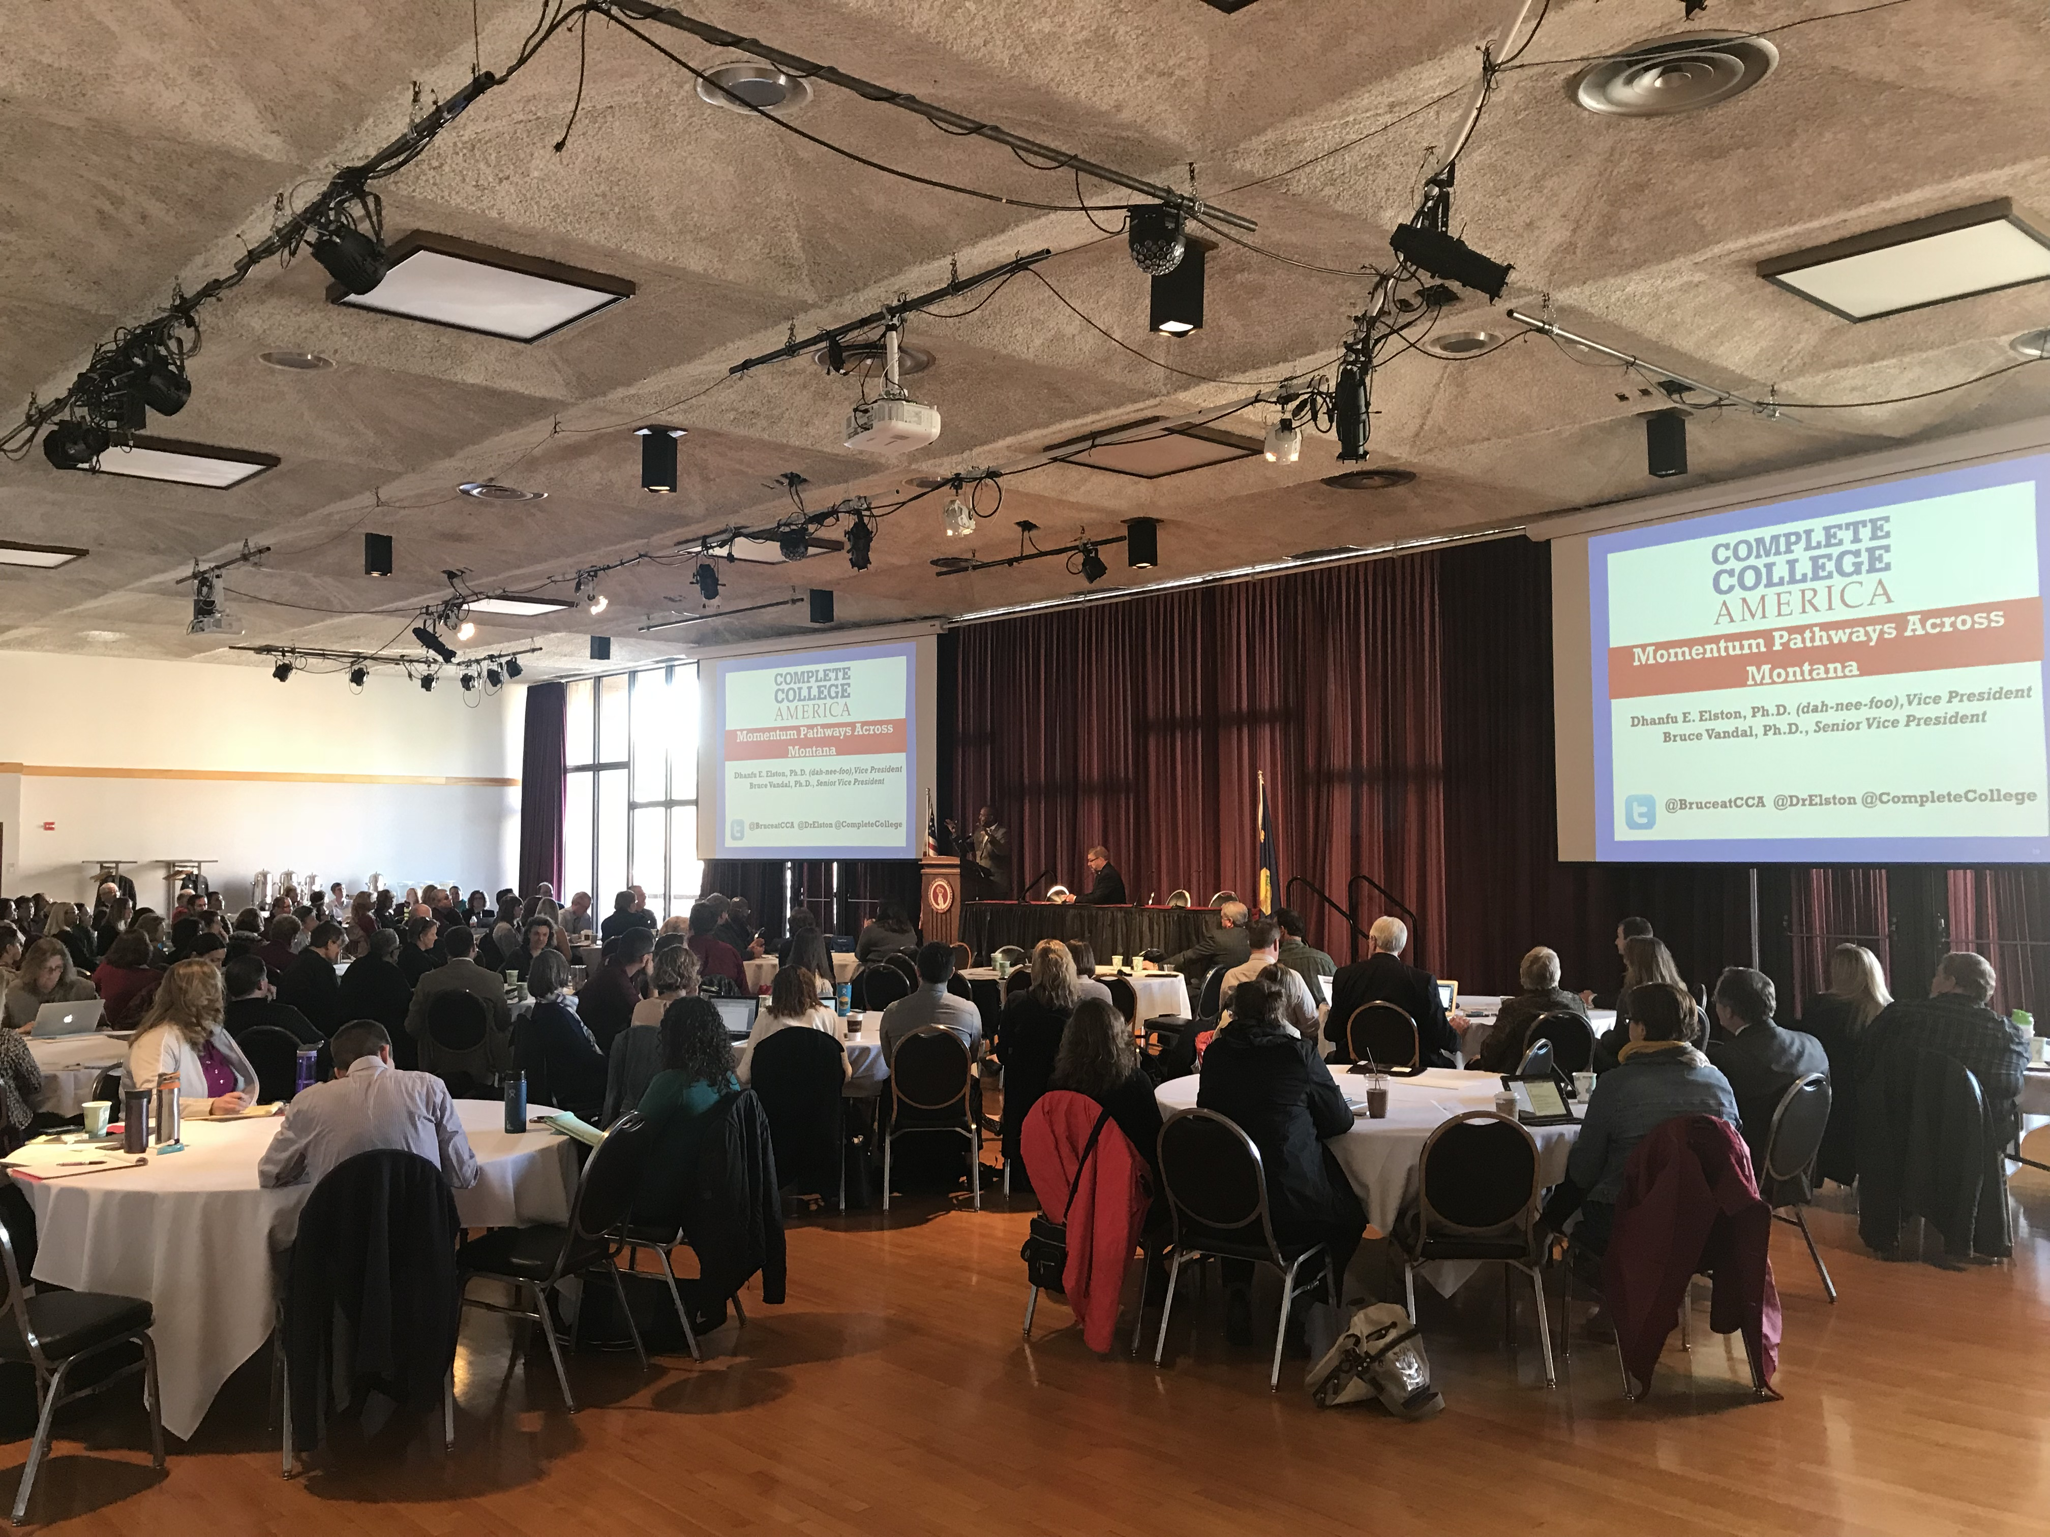
Complete College Montana Summit October 25th, 2017

Slide 15
Implementation Philosophy
Faculty Led
Administratively Supported
Notes:
John

Slide 16
Keeping Leadership Informed and Engaged
Notes:
Erik

Slide 17
Support from CCA
National Trainings
Technical Assistance
In-state Workshops
Content Experts
Notes:
Erik

Slide 18
The Complete College Montana Story:
Building Momentum in Montana
John Cech
Deputy Commissioner of Academic, Research, and Student Affairs
OCHE
Erik Rose
Director of Workforce Initiatives & Information
OCHE

