Slide 1
Gateway Course Success Initiative
Year One Outcomes Report
For Presentation to the
Academic, Research, and Student Affairs Committee
November 30, 2017

Slide 2
Gateway Success Report
A quick look back
Phase I – Task Force on Gateway Mathematics Success
Board adopted gateway course success policy in June 2015
Phase II – Implementation of Board policy
Phase II: English and Mathematics enrollment benchmarks set for 2016-17 (Year One) and 2017-18 (Year Two)
Today’s report – reviewing the outcomes for Year One and setting the stage for Phase III of the project
Phase III – course completions

Slide 3
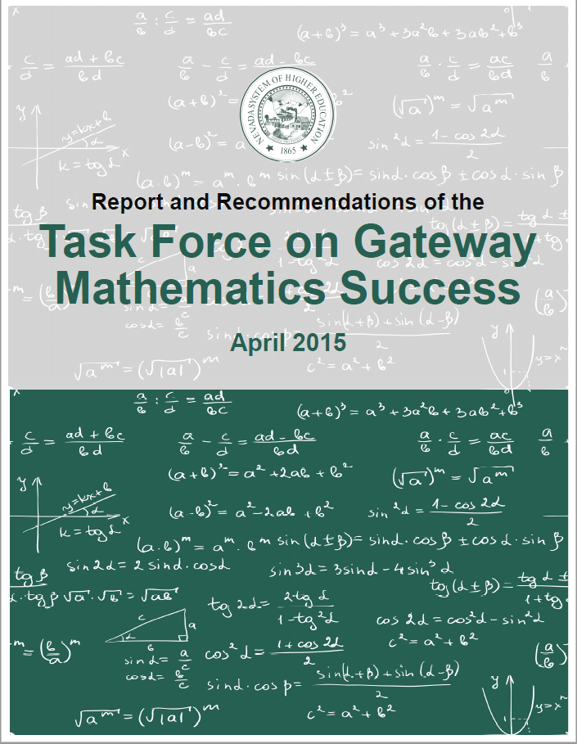
Phase I: The Task Force
October 2014 – Invited by Complete College America with six other states to participate in gateway course success project
November 2014 – Task Force of math faculty created
April 2015 – Report and Recommendations of Task Force issued
June 2015 – Board adopted recommendations of the Task Force

Slide 4
The Importance of Timely Gateway Mathematics Success
Impacts on Graduating Students
Fall 2007 cohort | % Completed Gateway Math in first 2 years | 150% Graduation Rate
UNLV | 59.5% | 48.8%
UNR | 79.2% | 52.0%
NSC | 37.0% | 25.0%
CSN | 16.9% | 23.2%
GBC | 17.5% | 26.8%
TMCC | 18.8% | 31.8%
WNC | 35.1% | 30.9%
% not Completed Gateway Math in first 2 years | 150% Graduation rate
40.5% | 22.6%
20.8% | 12.7%
63.0% | 3.9%
83.1% | 3.9%
82.5% | 1.8%
81.2% | 1.5%
64.9% | 0.3%
Task Force Finding: Timely completion of gateway mathematics courses
correlates with students persistence and degree completion.

Slide 5
The Challenge
Too many students do not enroll in any math course in their first year
Percent of first-time, degree-seeking students that did not enroll in math in the first year of enrollment (Fall 2012 cohort)
UNLV | 18.9%
UNR | 4.6%
NSC | 32.6%
CSN | 67.7%
GBC | 38.7%
TMCC | 31.2%
WNC | 30.1%
Enroll before you complete -- changing culture

Slide 6
Phase I: Board Policy Revision
Adopted June 2015
Title 4, Chapter 16, Section 1
Maintain the ACT “guarantee” for recent high school graduates with 12th grade conditions – originally adopted by the Board in December 2014
Degree-seeking students that place below college level, but are at least high school ready, must be placed on a pathway for gateway course completion (English and mathematics) within the first year of enrollment
Exception for students in a STEM program – placement into a three-semester sequence culminating in the gateway college algebra course
Generally, degree-seeking students must be continuously enrolled in the appropriate mathematics and English courses until the institutional core curriculum mathematics and English requirements are completed

Slide 7
Phase II: Implementation
Action Plans, Benchmarks, and Implementation
November 2015 and February 2016 – statewide meetings held to begin the process of developing institutional action plans and establishing data benchmarks to measure progress towards implementation
June 2016 – presented institutional action plans and data benchmarks to the ARSA Committee
2016-17 was Year One of implementation
Today’s report is on actual enrollment versus Year One benchmark – how are we doing on implementation?

Slide 8
Phase II: It takes a village
Tapping into UNR’s experience
Theo Meek, Coordinator of Records and Registration, UNR Admissions and Records/Enrollment Services, provided additional support to the institutions
Registration Holds
Workload challenges created by an often manual process
Changing institutional culture

Slide 9
Following UNR’s Lead
What does full implementation look like?

Slide 10
Percent of First-Time, Degree-Seeking Students that
Enrolled in Math in the First Year of Enrollment
BENCHMARKS – 4 YEAR INSTITUTIONS (MATH)
benchmark

Slide 11
Percent of First-Time, Degree-Seeking Students that
Enrolled in Math in the First Year of Enrollment
BENCHMARKS – 2 YEAR INSTITUTIONS (MATH)
benchmark
WNC

Slide 12
Percent of First-Time, Degree-Seeking Students that
Enrolled in English in the First Year of Enrollment
BENCHMARKS – 4 YEAR INSTITUTIONS (ENGLISH)
benchmark
UNLV
NSC

Slide 13
Percent of First-Time, Degree-Seeking Students that
Enrolled in English in the First Year of Enrollment
BENCHMARKS – 2 YEAR INSTITUTIONS (ENGLISH)
benchmark
CSN
GBC
TMCC

Slide 14
UNLV Outcomes
Benchmark vs. Actual for Year One
MATH:
103 students enrolled over benchmark
ENGLISH:
29 students short of benchmark
Cohort:
3,200 students
BENCHMARK
Best Practice: Utilizing block scheduling for math enrollment

Slide 15
NSC Outcomes
Benchmark vs. Actual for Year One
MATH:
31 students enrolled over benchmark
ENGLISH:
34 students enrolled over benchmark
Cohort:
286 students
Best Practice: Intrusive Advising Holds

Slide 16
CSN Outcomes
Benchmark vs. Actual for Year One
MATH:
92 students enrolled over benchmark
ENGLISH:
464 students enrolled over benchmark
Cohort:
4,225 students
Best Practice: First Steps Advising and Orientation Process

Slide 17
GBC Outcomes
Benchmark vs. Actual for Year One
MATH:
14 students enrolled over benchmark
ENGLISH:
2 students enrolled over benchmark
Cohort:
261 students
Best Practice: First-Year Experience Course for Cohort

Slide 18
TMCC Outcomes
Benchmark vs. Actual for Year One
MATH:
63 students short of benchmark
ENGLISH:
3 students short of benchmark
Cohort:
1,259 students
Best Practice: Faculty mentoring for students in the cohort

Slide 19
WNC Outcomes
Benchmark vs. Actual for Year One
MATH:
32 students enrolled over benchmark
ENGLISH:
11 students enrolled over benchmark
Cohort:
713 students
Best Practice: Specialized cohorts and block scheduling

Slide 20
Phase III: Course Completions
Shifting focus from enrollment to course completion
The Board policy focuses on putting students on a path to gateway course completion
Backed by state and national data
Complete College America supported
Phase II of the project focused on enrollment and changing institutional culture – getting students on the pathway
Phase III is about the end game – course completion and ultimately student success

Slide 21
Next Steps
Culture changes take time --- time and attention ☺ -- 4-Year institutions are there!
Extend Year Two enrollment benchmarks to Year Three (2018-19) and adjust for the community colleges
Start reviewing data on course completions percentages
Re-establish Task Force to identify challenges to course completion

Slide 22
Questions?

